Slide 1

Python Level 2
Lesson 6: Pip! Pip! Hooray!

Slide 2
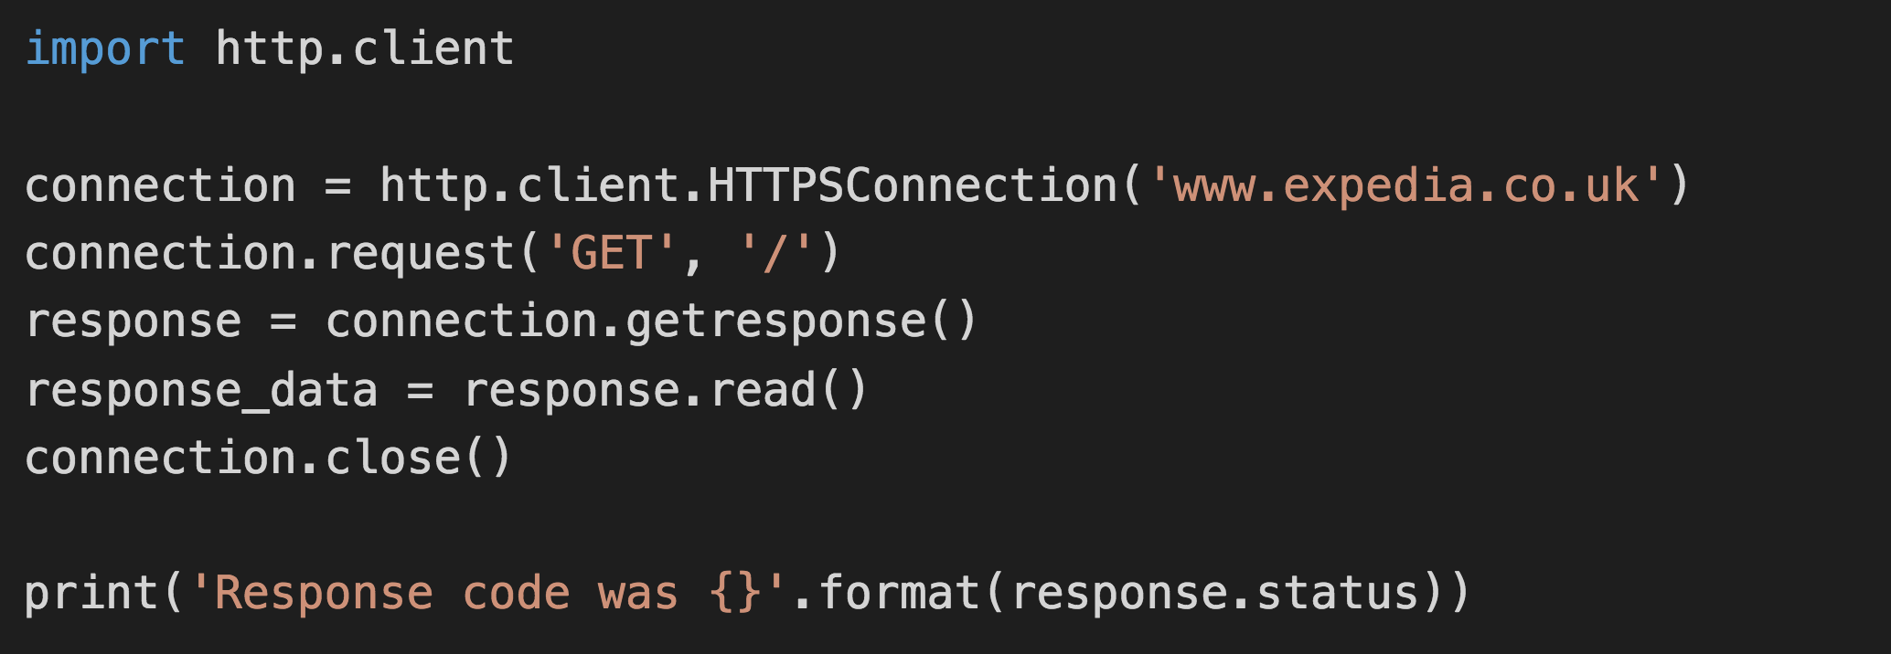

Last time

Slide 3
Pip Installs Packages
Python Package Index: https://pypi.python.org/pypi
To install a package:
pip3 install <packagename>
For a specific version:
pip3 install <packagename>=<version>
Eg: pip3 install mypackage=0.1.0
You know what’s coming…

Slide 4
Pip Installs Packages
Python Package Index: https://pypi.python.org/pypi
To install a package:
pip3 install <packagename>
You know what’s coming…
There’s a problem using pip - what is it?

Slide 5
Version Conflicts, System conflicts
What happens if
Program A needs version 1 of a module
Program B needs version 2 of the same module
The solution: pipenv
pip3 install pipenv
pipenv installs some other modules (notably virtualenv)

Slide 6
Creating a new virtual environment
Windows and MacOS:
cd <wherever your code is saved – eg c:\Users\myname…>
pipenv install bottle
PyCharm user? I’ll show you.
Other IDEs, you’re on your own – sorry!

Slide 7
Using our virtual environment
We’re going to need a new module for the rest of today’s class
We’ve already installed it!
Introducing the module called bottle…

Slide 8
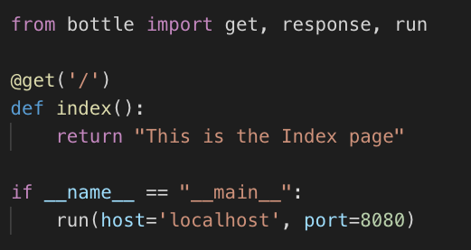
Building a web server

Slide 9
Running our webserver
To run:
pipenv run python webserver.py

Slide 10
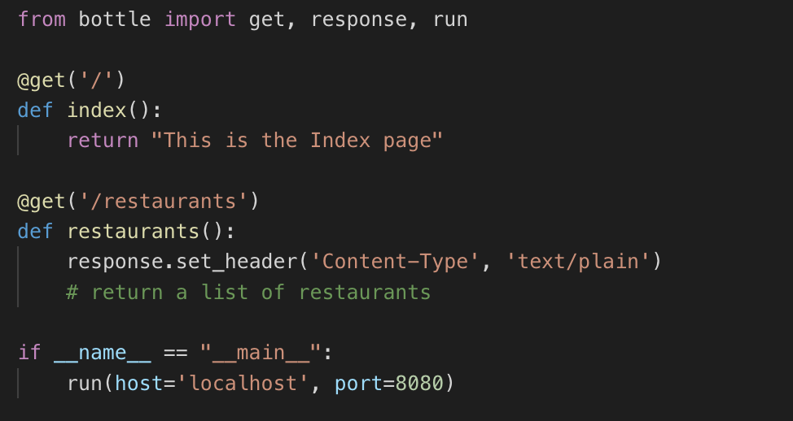
Passing Request data in

Slide 11
Serving up data on the Interwebs
We want to be able to list the restaurants we have data about:
Implement the list of restaurants from the previous slide.
You will need shared.py from a previous week’s exercises
Next week: Dynamic content generation!

